Slide 1


Microsoft Certifications and the road to a tech job
Sat, May 28 | 2:30PM BST - 2:40PM BST
In Person event
Rosen Georgiev
Security Technical Specialist Microsoft Cybersecurity

Slide 2
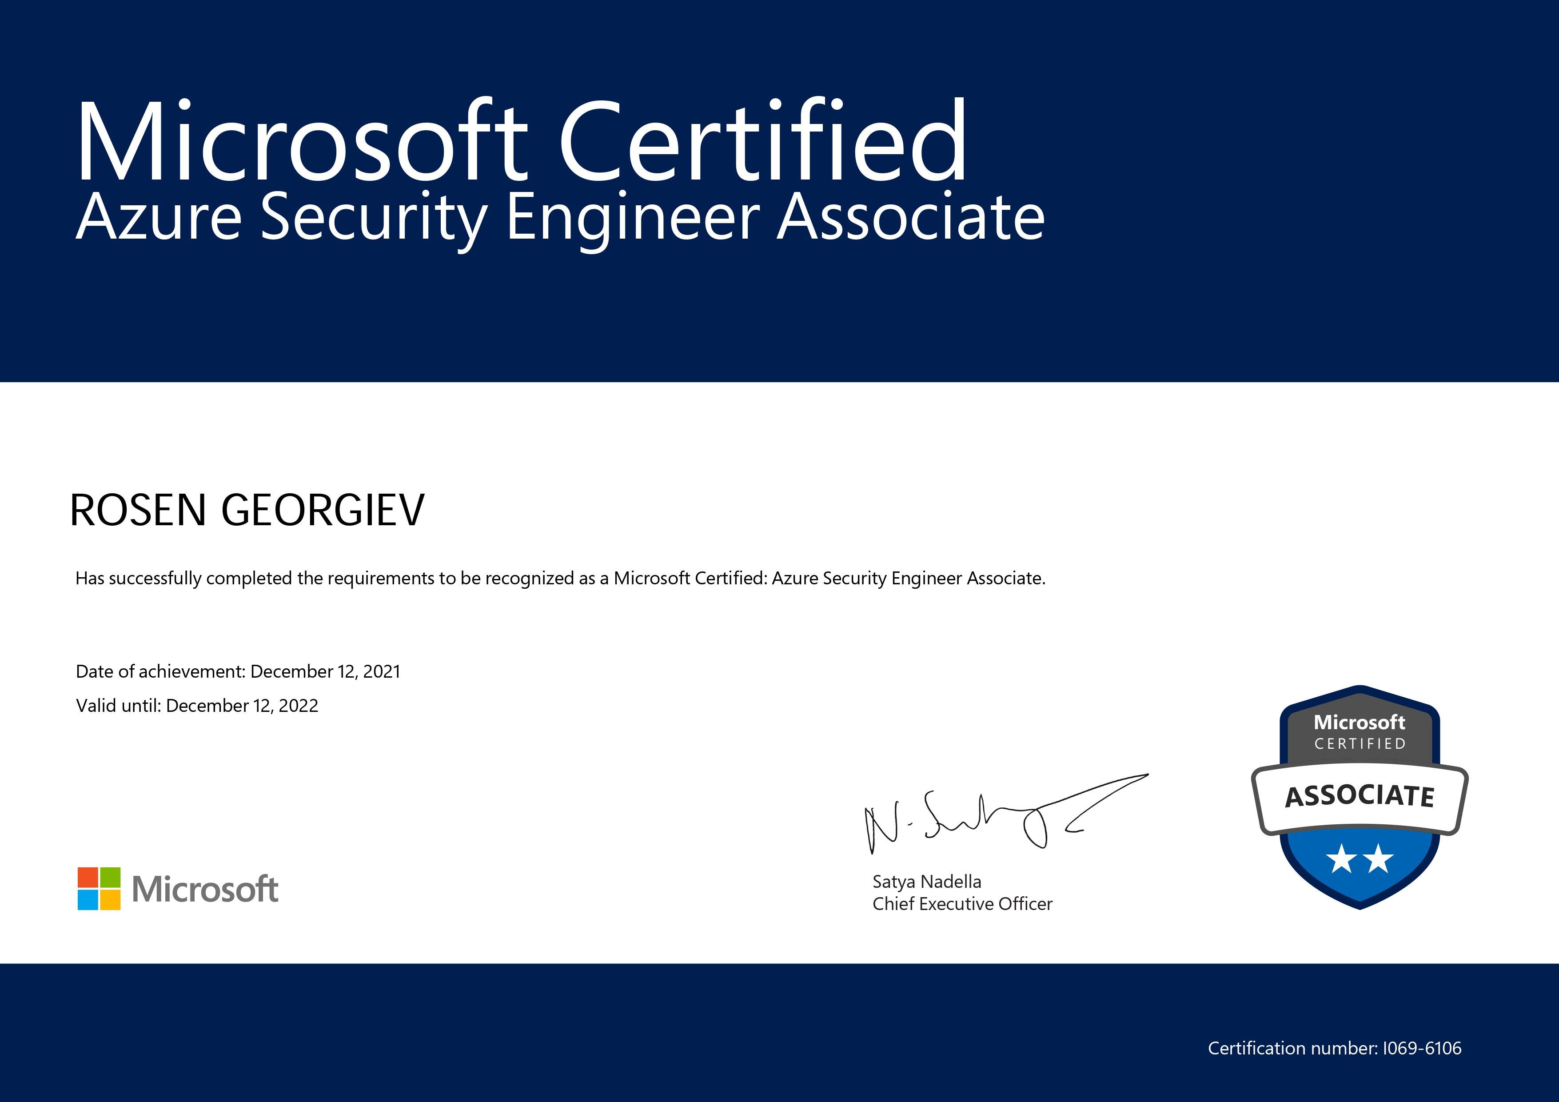
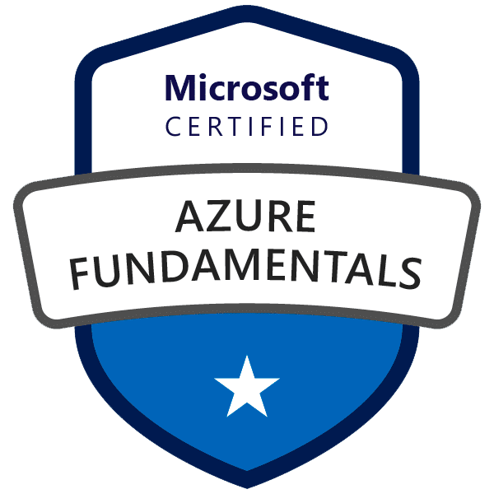
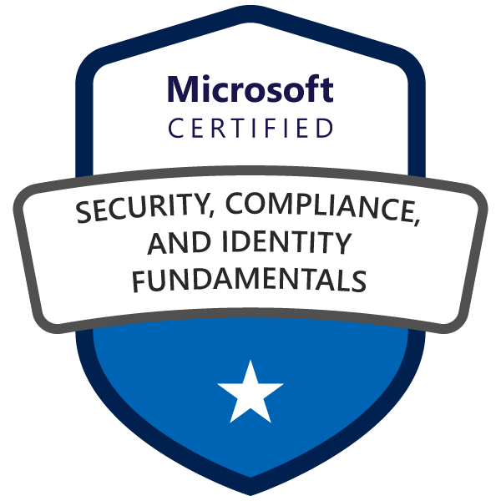
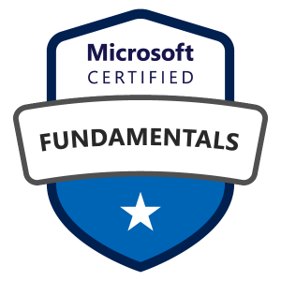
Microsoft Certifications Why to get certified?
Microsoft Certification is based on industry-defined roles and on the skills needed to perform those roles
Get hired faster, get recognized and get promoted
Certification isn’t just for high-tech roles
Notes:
Why get Certified? Experience is great, but how do you demonstrate your knowledge and skills to employers and colleagues? Certification. But what kind? Microsoft Certification is based on industry-defined roles and on the skills needed to perform those roles. All the educational resources for certification at Microsoft Learn are aligned to these roles. That’s what makes Microsoft Certification so valuable. It demonstrates that you’re proficient in the specific, real-world skills associated with recognized industry roles. It verifies that you know how to apply technical knowledge to solve today’s business challenges. And it helps you keep up with industry changes, because the training is always being updated and new certifications are being added all the time
Certification isn’t just for high-tech roles
There’s a high demand today for IT professionals with skills in security, networking, and the cloud. And, according to a 2018 report on the value of IT certification, those are the top three fields people sought certification in. There’s also a rapidly growing demand for people with AI skills - in every field, including business apps.
But it’s not only developers, cloud solution architects, and cybersecurity experts, however, who need to demonstrate their skills. More and more industry roles require proficiency in specialized skills. As the business world continues its digital transformation, the need for people with skills using the latest technologies increases, which means that sales managers, marketers, brand developers, data analysts, and business apps solution developers and architects can also benefit from certification.
How can Microsoft role-based certification help you?
Getting ahead is not magic, luck, or guesswork. You have to plan for success, and you can do that by following a path to certification. Whichever certification level you choose - fundamental, associate, or expert - and whichever role you want to become certified in, by verifying your skills, you’ll unlock opportunities. When you pass a Microsoft Certification exam, you’ll earn a digital badge, which you can share online with your professional network.
Get hired—faster. Certification validates your skills, which means you’ll have what you need to stand out as a great candidate. Employers regularly use certification as a criterion for hiring. New hires who are certified reach full productivity a month sooner than non-certified hires, and they have more opportunities for advancement, too.
Get recognized. By building or updating your skills, you can reach full productivity sooner and become an indispensable employee or team member. Compared to their peers, Microsoft-certified developers are 90 percent more productive and nearly 60 percent more efficient. In the 2018 Pearson VUE report, 36.9 percent of IT professionals claimed that certification helped them perform complex tasks more confidently. Certification demonstrates not only your skills mastery but also your willingness to embrace new technologies and your commitment to lifelong learning and growth. For these reasons, in many certification surveys a large majority of respondents report being acknowledged as a valuable employee after certification.
Get promoted. Certification can distinguish you from other professionals and can improve your opportunities for advancement in your current role or organization. Certified employees are often entrusted with supervising their peers—putting them on the fast track for a promotion. In fact, employers regularly use certification as a criterion for promotion.
Satisfaction. Don’t take our word for it. Listen to those who have achieved their goals. In 2018, 90 percent of people who earned certification said they would recommend it to a colleague.

Slide 3

How to get a job in tech?
Know the space
Polish relevant IT skills
Build your experience
Network
Look for entry-level positions
Polish your interview skills
Notes:
1. Know the space.
If you’re interested in IT work, it’s a good idea to know what exactly that would look like, and what kinds of jobs are out there. Try putting together a list of jobs that you’re interested in. Are you interested in helping an organization’s computer networks function smoothly, or are you interested in developing websites? What sort of organizations are appealing to you? What positions sound like something you’d want to do? This can help focus your job search.
2. Polish relevant IT skills.
Specific skills that employers are looking for in IT workers can vary from role to role. Look through several job listings you’re interested in to see what specific skills you should sharpen. Here a few skills you might find listed in an IT job description.
Operating systems: Familiarity with Mac, Linux, and Microsoft operating systems can put you in a good position to work with a variety of devices and can broaden the organizations you’re qualified to work for.
Security: A fundamental understanding of computer and internet security can be useful to your life as an IT professional. This can include concepts like encryption and firewalls.
Networks: Knowing the essentials of networking issues, like network access and IP services, may give you a leg up in your job search.
3. Build your experience.
Whether you’re trying to be a network engineer or system administrator, experience working in your field is likely to be one of your strongest assets when it comes to getting a job. There are several ways you can gain experience.
Coursework: Coursework, whether online or in-person, often requires you to complete hands-on projects or tasks. Some may also prepare you for certification exams. Not sure where to start? Take a look at the Google IT Support Professional Certificate, which prepares you for the CompTIA A+ certification. You may also find introductory IT courses at your local community college, or elsewhere online.
Personal projects: If you work well without having too much structure, you can try to learn through personal projects. Creating your own software, building a website for a friend, or tinkering with a computer network can put your skills to the test and give you something to point to in job applications.
Internships: Internships may not require previous experience and can be a good opportunity to use your skills in a professional setting.
Volunteering: Many volunteer organizations are looking for support. Offering your skills can help you complete hands-on projects that you can refer to in a job application.
Education: Though having a degree isn’t a must for many IT jobs, you can gain the in-depth knowledge you need by studying a related field like computer science or computer engineering. If you have the time and resources to put into an associate or bachelor’s degree, it’s a path worth considering.
4. Get a certification.
Certifications can be a good way to earn a credential and learn fundamental IT concepts. If you're completely new to the field, you can learn a wide variety of basic IT concepts by getting a general entry-level certification
5. Network.
Networking can be a useful way to find more about a job or company, introduce you to opportunities you wouldn’t have heard of otherwise, or get you a boost in the hiring process. Your network can include old coworkers, friends, family, alumni of your alma maters, or people you reach out to through professional sites like LinkedIn.
Remember that successful networking doesn't always have to end in a new job. You can also network to learn more about what it's like to work in IT, or get some advice about your job search process.
6. Look for entry-level positions.
7. Polish your interview skills.
In an interview for a job in IT, you’re likely to encounter both behavioral questions and technical questions. Read the job description to get a sense of what you’ll be expected to know. Have some stories ready about your past experiences, including times where things went well, and when things didn’t go so well—and what you did about it.

Slide 4
Kick-start your tech career with Microsoft Certification!
Student Certification
https://aka.ms/LondonReactorStudentCertification
Cloud Skills Challenge
https://aka.ms/StudentDeveloperDayChallenge
Notes:
At Microsoft, our mission is to help you achieve more, so we’re making certifications, and the resources to learn, prepare, and get certified, free to all eligible students, starting with fundamentals certifications.

